Slide 1
XML

Slide 2
What is XML?
XML stands for “Extensible Markup Language
XML is a “metalanguage” that can be used to create markup languages
XML languages can be created to describe specific data
XML is an open standard, meaning that it is not tied to any specific technologies
XML files can be created and edited with a text editor
XML is a general-purpose information storage system

Slide 3
Markup Language Fundamentals
A “markup language” is a set of rules that define the structure of a document
Programs, or applications, are used to interpret documents containing markup
Some applications contain rules and instructions that can produce documents that can only be interpreted by that application – this is known as a “proprietary” format
XML documents are “portable” because they can be interpreted by many different applications

Slide 4
The Beginning:SGML
SGML stands for “Standard Generalized Markup Language”
SGML was developed in the 1960’s and was the first standardized markup language
SGML provides a framework for creating other markup languages
XML and HTML are both SGML languages
SGML is used mainly for very large documentation projects

Slide 5
HTML
HTML was developed in the mid 1990’s as a lightweight language to be used for exchanging information over the World Wide Web
HTML is an open standard, meaning that it is free to use and not tied to any particular technology
HTML documents, like XML documents, are plain text documents and can be created using a text editor
HTML is limited in it’s scope and can not be extended

Slide 6
The Need for XML
XML was developed partly because of the limitations of HTML
The W3C (World Wide Web Consortium) released the official XML version 1.0 specification in 1998
XML quickly gained popularity in the Web community
XML itself is NOT a language, but rather a set of tools that can be used to create markup languages

Slide 7
Benefits of XML
XML:
Allows data to be self-describing
Allows an author to create rules for the content an element can contain
Languages can be developed for industry-specific or company-specific needs
Elements describe the data, not the format
Provides extensive linking functionality
Can be used to interchange data between two proprietary formats
Can be used to define standard syntax for many different languages
Contains robust searching capabilities

Slide 8
Data vs. Presentation
XML elements describe data properties
HTML elements describe formatting properties
XML elements can be formatted by using “style sheets”
A style sheet is a set of instructions that describes how to format a document
Many style sheets can be created to provide different presentations of a single document (ie – print vs. web page)
A single style sheet can be used to provide formatting instructions for many XML documents

Slide 9
Differences Between XML and HTML
XML is not dependant on a single document type
XML allows an author to create elements that best fit the data
XML separates data from presentation
XML is strict about syntax
XML tags are case-sensitive
XML documents can be used with many different clients, not just web browsers
XML documents require style sheets for their formatting information

Slide 10
XHTML: The Best of Both Worlds
XHTML stands for “Extensible Hypertext Markup Language”
XHTML is a language that is meant to merge HTML and XML
XHTML contains the HTML element set, but adheres to XML’s syntax rules
XHTML is extensible
XHTML is accepted by many browsers

Slide 11
XML Document Example
<?xml version=”1.0”?>
<job-posting>
<title>Job Title: <emphasis>Webmaster</emphasis></title>
<description>We are looking for a Webmaster to oversee the management of our company website. The Webmaster will be responsible for working with other staff members to collect information for the website, and for creating and maintaining the web pages.</description>
<skill-list>
<skill>Basic writing skills</skill>
<skill>good communication skills</skill>
<skill>HTML</skill>
</skill-list>
</job-posting>

Slide 12
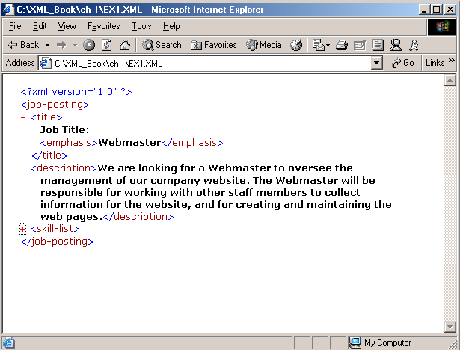
XML Document Example

Slide 13
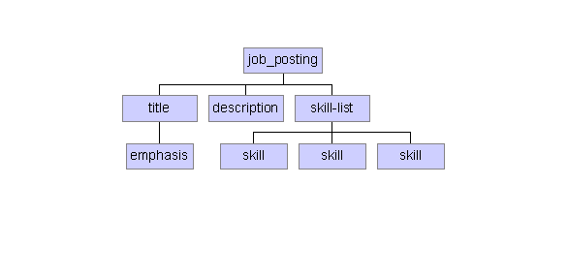
XML Element Structure

Slide 14
XML Goals
Form should follow function - Markup languages need to fit their data snugly. Rather than invent a single, generic language to cover all document types (badly), let there be many languages, each specific to its data.
A document should be unambiguous - Markup should occur so there is only one way to interpret the names, order, and hierarchy of the elements.
Separate markup from presentation - Documents should have style information stored externally, outside the body of the document. Documents that rely on stylistic markup are difficult to repurpose or convert into new forms. (stylesheets)
Keep it simple - widespread acceptance and use requires simplicity

Slide 15
XML Goals
Enforce maximum error checking - Some markup languages are so lenient about syntax that errors go undiscovered. When errors build up in a file, it no longer behaves the way you want it to.; its appearance in a browser is unpredictable, information may be lost, and programs may act strangely. - The XML specification requires the use of well-formed documents.
Culture agnostic A markup language should not be limited by particular alphabets or symbols.

Slide 16
XML Elements
Core components of XML document
Consist of
Start tag: <element>
Content: data or other elements or both
End tag: </element>
Elements are like English nouns – definable objects

Slide 17
Element Examples
Start tag
<book>
Here is Edward Bear, coming downstairs now, bump, bump, bump on the back of his head, behind Christopher Robin. It is, as far as he knows, the only way of coming downstairs, but sometimes he feels that there really is another way, if only he could stop bumping for a moment and think of it.
…
</book>
Content
End tag

Slide 18
Element Examples
<email_message>
Dear CS 1520:
Web programming is sure fun!
</email_message>
<plane>
F117 Nighthawk
</plane>

Slide 19
Root element
All XML documents contain
Outermost element – root element
All other elements and data within document further describe root
<book>
<title> Programming the World Wide Web </title>
<author> Robert Sebesta </author>
<publisher> Addison-Wesley </publisher>
</book>

Slide 20
Elements are containers
Elements contain
Elements and contents (data)
Elements can nest within each other
May contain child elements e.g.,<title> contained within <book>
Empty elements
In html, <br> <p>
In XML (or XHTML) <br/> <p/>

Slide 21
XML Attributes
Information that describes elements
Similar to an adjective - adding more to the definition
Defined in the start tag of elements
Attributes are name-value pairs
Value must be in quotes
Same idea as with HTML attributes

Slide 22
XML Attributes
Examples:
<movie source="http://www.starwars.com/the-force-awakens/">Star Wars The Force Awaken</movie>
<band genre=“Post-punk”>Joy Division</band>
We can either use elements or attributes to modify tags – up to programmer and situation
See p. 281-282 of Sebesta (8th edition)
One approach is to use attributes only for items that are not content-related
Ex: an id for an element

Slide 23
XML Attributes
<band name = “Joy Division” genre = “Post-Punk”></band>
Vs
<band>
<name>Joy Division</name>
<genre>Post-Punk</genre>
</band>
XML purists prefer second approach (minimal attributes)
Generally more flexible / extensible
But a bit more wordy as well

Slide 24
Well-Formed XML
Document must adhere to syntax rules:
All documents must contain one and only one root element
Elements must have a start and end tag
E.g., <article> ... </article>
Except: <image/> is same as <image></image>

Slide 25
Well-Formed XML
Elements must be nested properly and can not overlap; each element must be contained completely inside its parent
Right: <book><chapter>...</chapter></book>
Wrong: <book><chapter>..</book></chapter>
Attributes must have a value and must be enclosed in quotes
<greeting value=“Hello!”>

Slide 26
Well-Formed XML
Attributes must be placed in start tag and a particular attribute may only appear once in the start tag
Element names are case-SENSITIVE
Element names start with letters or an underscore; can have letters, numbers, hyphens, periods, & underscores

Slide 27
Well-Formed XML
We can use Document Type Definitions (DTDs) or Schemas to impose structural rules on our XML
Can list the elements, attributes and entities
Can also impose some rules on frequency and proper use
We will just discuss these superficially but you can read the text for more information on Schemas

Slide 28
XML DTD
A DTD is a set of rules that allow us to specify our own set of elements and attributes.
DTD is grammar to indicate what tags are legal in XML documents.
XML Document is valid if it has an attached DTD and document is structured according to rules defined in DTD.

Slide 29
DTD Example
<BOOKLIST>
<BOOK GENRE = “Science” FORMAT = “Hardcover”>
<AUTHOR>
<FIRSTNAME> RICHRD </FIRSTNAME>
<LASTNAME> KARTER </LASTNAME>
</AUTHOR>
</BOOK>
</BOOKS>
<!DOCTYPE BOOKLIST[
<!ELEMENT BOOKLIST(BOOK)*> <!ELEMENT BOOK(AUTHOR)>
<!ELEMENT AUTHOR(FIRSTNAME,LASTNAME)>
<!ELEMENT FIRSTNAME(#PCDATA)>
<!ELEMENT>LASTNAME(#PCDATA)>
<!ATTLIST BOOK GENRE (Science|Fiction)#REQUIRED>
<!ATTLIST BOOK FORMAT (Paperback|Hardcover) “PaperBack”>]>
Xml Document And Corresponding DTD

Slide 30
XML Schema
Serves same purpose as database schema
Schemas are written in XML
Set of pre-defined simple types (such as string, integer)
Allows creation of user-defined complex
types

Slide 31
XML Schema
RDBMS Schema (s_id integer, s_name string, s_status string)
XMLSchema
<Students>
<Student id=“p1”>
<Name>Allan</Name>
<Age>62</Age>
<Email>allan@abc.com
</Email>
</Student>
</Students>
<xs:schema>
<xs:complexType name = “StudnetType”>
<xs:attribute name=“id” type=“xs:string” />
<xs:element name=“Name” type=“xs:string />
<xs:element name=“Age” type=“xs:integer” />
<xs:element name=“Email” type=“xs:string” />
</xs:complexType>
<xs:element name=“Student” type=“StudentType” />
</xs:schema>
XML Document and Schema

Slide 32
XML Query Languages
Requirement
Same functionality as database query languages (such as SQL) to process Web data
Advantages
Query selective portions of the document (no need to transport entire document)
Smaller data size mean lesser communication cost

Slide 33
XQuery
XQuery to XML is same as SQL to
RDBMS
Most databases supports XQuery
XQuery is built on XPath operators
(XPath is a language that defines path
expressions to locate document data)

Slide 34
XPath Example
<Student id=“s1”>
<Name>John</Name>
<Age>22</Age>
<Email>jhn@xyz.com</Email>
</Student>
XPath: /Student[Name=“John”]/Email
Extracts: <Email> element with value “jhn@xyz.com”

Slide 35
Examples
<Patients>
<Patient id=“p1”>
<Name>John</Name>
<Address>
<Street>120 Northwestern Ave</Street>
</Address>
</Patient>
<Patient id=“p2”>
<Name>Paul</Name>
<Address>
<Street>120 N. Salisbury</Street>
</Address>
</Patient>
</Patients>

Slide 36
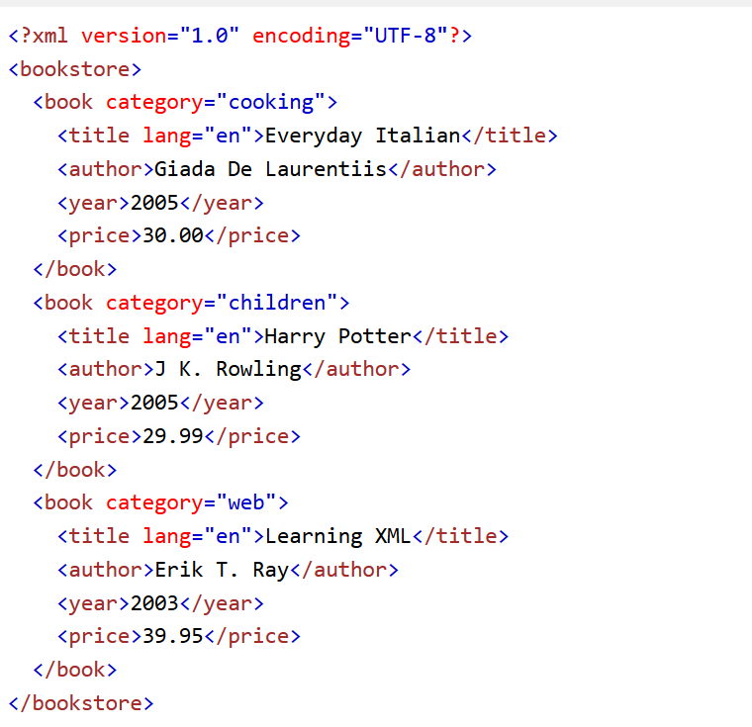
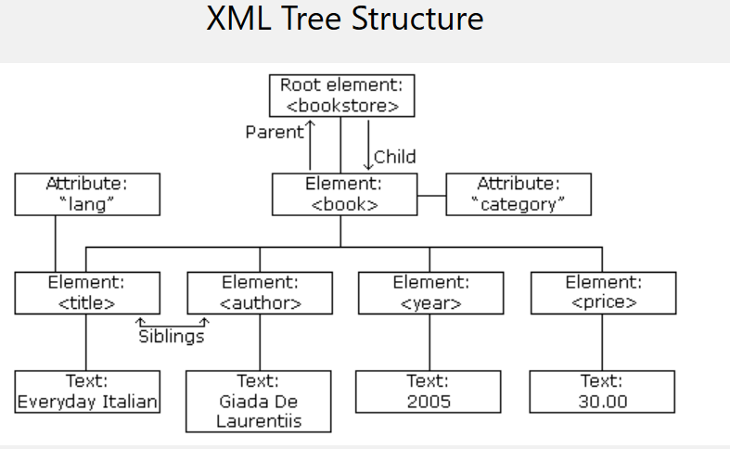
XML Tree Structure

Slide 37
XML Parsing Example
All major browsers have a built-in XML parser to access and manipulate XML.
The XML DOM defines the properties and methods for accessing and editing XML.
However, before an XML document can be accessed, it must be loaded into an XML DOM object.
All modern browsers have a built-in XML parser that can convert text into an XML DOM object.
Parsing a Text String
This example parses a text string into an XML DOM object, and extracts the info from it with JavaScript:

Slide 38
What is SAX?
SAX stands for Simple API for XML. Its main characteristic is that as it reads each unit of XML, it creates an event that the calling program can use.
This allows the calling program to ignore the bits it doesn't care about, and just keep or use what it likes.
The disadvantage is that the calling program must keep track of everything it might ever need.
SAX is often used in certain high-performance applications or areas where the size of the XML might exceed the memory available to the running program.

Slide 39
What's a DOM?
DOM stands for Document Object Model. It differs from SAX in that it builds the entire XML document representation in memory
It then hands the calling program the whole chunk of memory.
DOM can be very memory intensive; by the time you figure in the overhead for managing the relationships of the nodes.
DOM (currently up to level 3.0) has been widely criticized for being too complicated;
It has tried to maintain the same programming interface for whatever language it is implemented in, even if it violates some of the conventions of that language.
This has led to some DOM-like implementations that are more in keeping in line with the philosophy of the local language.
Examples in Java include TinyTree (used only in Saxon), JDOM, DOM4J and XOM.

Slide 40
Syntax and Structure Components of an XML Document
Elements
Each element has a beginning and ending tag
<TAG_NAME>...</TAG_NAME>
Elements can be empty (<TAG_NAME />)
Attributes
Describes an element; e.g. data type, data range, etc.
Can only appear on beginning tag
Processing instructions
Encoding specification (Unicode by default)
Namespace declaration
Schema declaration

Slide 41
Syntax and Structure Components of an XML Document
<?xml version=“1.0” ?>
<?xml-stylesheet type="text/xsl” href=“template.xsl"?>
<ROOT>
<ELEMENT1><SUBELEMENT1 /><SUBELEMENT2 /></ELEMENT1>
<ELEMENT2> </ELEMENT2>
<ELEMENT3 type=‘string’> </ELEMENT3>
<ELEMENT4 type=‘integer’ value=‘9.3’> </ELEMENT4>
</ROOT>
Elements with Attributes
Elements
Prologue (processing instructions)

Slide 42
Syntax and Structure Rules For Well-Formed XML
There must be one, and only one, root element
Sub-elements must be properly nested
A tag must end within the tag in which it was started
Attributes are optional
Defined by an optional schema
Attribute values must be enclosed in “” or ‘’
Processing instructions are optional
XML is case-sensitive
<tag> and <TAG> are not the same type of element

Slide 43
Syntax and Structure An XML Document
<?xml version='1.0'?>
<bookstore>
<book genre=‘autobiography’ publicationdate=‘1981’
ISBN=‘1-861003-11-0’>
<title>The Autobiography of Benjamin Franklin</title>
<author>
<first-name>Benjamin</first-name>
<last-name>Franklin</last-name>
</author>
<price>8.99</price>
</book>
<book genre=‘novel’ publicationdate=‘1967’ ISBN=‘0-201-63361-2’>
<title>The Confidence Man</title>
<author>
<first-name>Herman</first-name>
<last-name>Melville</last-name>
</author>
<price>11.99</price>
</book>
</bookstore>

Slide 44
Syntax and Structure Namespaces: Overview
Part of XML’s extensibility
Allow authors to differentiate between tags of the same name (using a prefix)
Frees author to focus on the data and decide how to best describe it
Allows multiple XML documents from multiple authors to be merged
Identified by a URI (Uniform Resource Identifier)
When a URL is used, it does NOT have to represent a live server
Notes:
URLs and URNs for namespaces do not have to be “live” – they only need to be unique strings.

Slide 45
Syntax and Structure Namespaces: Declaration
Namespace declaration examples:
xmlns: bk = “http://www.example.com/bookinfo/”
xmlns: bk = “urn:mybookstuff.org:bookinfo”
xmlns: bk = “http://www.example.com/bookinfo/”
Namespace declaration
Prefix
URI (URL)

Slide 46
Syntax and Structure Namespaces: Examples
<BOOK xmlns:bk=“http://www.bookstuff.org/bookinfo”>
<bk:TITLE>All About XML</bk:TITLE>
<bk:AUTHOR>Joe Developer</bk:AUTHOR>
<bk:PRICE currency=‘US Dollar’>19.99</bk:PRICE>
<bk:BOOK xmlns:bk=“http://www.bookstuff.org/bookinfo” xmlns:money=“urn:finance:money”>
<bk:TITLE>All About XML</bk:TITLE>
<bk:AUTHOR>Joe Developer</bk:AUTHOR>
<bk:PRICE money:currency=‘US Dollar’>
19.99</bk:PRICE>

Slide 47
Syntax and Structure Namespaces: Default Namespace
An XML namespace declared without a prefix becomes the default namespace for all sub-elements
All elements without a prefix will belong to the default namespace:
<BOOK xmlns=“http://www.bookstuff.org/bookinfo”>
<TITLE>All About XML</TITLE>
<AUTHOR>Joe Developer</AUTHOR>

Slide 48
Syntax and Structure Namespaces: Scope
Unqualified elements belong to the inner-most default namespace.
BOOK, TITLE, and AUTHOR belong to the default book namespace
PUBLISHER and NAME belong to the default publisher namespace
<BOOK xmlns=“www.bookstuff.org/bookinfo”>
<TITLE>All About XML</TITLE>
<AUTHOR>Joe Developer</AUTHOR>
<PUBLISHER xmlns=“urn:publishers:publinfo”>
<NAME>Microsoft Press</NAME>
</PUBLISHER>
</BOOK>

Slide 49
The XML ‘Alphabet Soup’
XML | Extensible Markup Language | Defines XML documents
Infoset | Information Set | Abstract model of XML data; definition of terms
DTD | Document Type Definition | Non-XML schema
XSD | XML Schema | XML-based schema language
XDR | XML Data Reduced | An earlier XML schema
CSS | Cascading Style Sheets | Allows you to specify styles
XSL | Extensible Stylesheet Language | Language for expressing stylesheets; consists of XSLT and XSL-FO
XSLT | XSL Transformations | Language for transforming XML documents
XSL-FO | XSL Formatting Objects | Language to describe precise layout of text on a page

Slide 50
The XML ‘Alphabet Soup’
XPath | XML Path Language | A language for addressing parts of an XML document, designed to be used by both XSLT and XPointer
XPointer | XML Pointer Language | Supports addressing into the internal structures of XML documents
XLink | XML Linking Language | Describes links between XML documents
XQuery | XML Query Language (draft) | Flexible mechanism for querying XML data as if it were a database
DOM | Document Object Model | API to read, create and edit XML documents; creates in-memory object model
SAX | Simple API for XML | API to parse XML documents; event-driven
Data Island | XML data embedded in a HTML page
Data Binding | Automatic population of HTML elements from XML data

Slide 51
Schemas
DTD (Document Type Definitions)
Not written in XML
No support for data types or namespaces
XSD (XML Schema Definition)
Written in XML
Supports data types
Current standard recommended by W3C

Slide 52
Schemas :Purpose
Define the “rules” (grammar) of the document
Data types
Value bounds
A XML document that conforms to a schema is said to be valid
More restrictive than well-formed XML
Define which elements are present and in what order
Define the structural relationships of elements

Slide 53
Schemas: DTD Example
XML document:
DTD schema:
<BOOK>
<TITLE>All About XML</TITLE>
<AUTHOR>Joe Developer</AUTHOR>
</BOOK>
<!DOCTYPE BOOK [
<!ELEMENT BOOK (TITLE+, AUTHOR) >
<!ELEMENT TITLE (#PCDATA) >
<!ELEMENT AUTHOR (#PCDATA) >
]>

Slide 54
Schemas: XSD Example
XML document:
<CATALOG>
<BOOK>
<TITLE>All About XML</TITLE>
<AUTHOR>Joe Developer</AUTHOR>
</BOOK>
…
</CATALOG>

Slide 55
Schemas: XSD Example
<xsd:schema id="NewDataSet“ targetNamespace="http://tempuri.org/schema1.xsd"
xmlns="http://tempuri.org/schema1.xsd"
xmlns:xsd="http://www.w3.org/1999/XMLSchema"
xmlns:msdata="urn:schemas-microsoft-com:xml-msdata">
<xsd:element name="book">
<xsd:complexType content="elementOnly">
<xsd:all>
<xsd:element name="title" minOccurs="0" type="xsd:string"/>
<xsd:element name="author" minOccurs="0" type="xsd:string"/>
</xsd:all>
</xsd:complexType>
</xsd:element>
<xsd:element name=“Catalog" msdata:IsDataSet="True">
<xsd:complexType>
<xsd:choice maxOccurs="unbounded">
<xsd:element ref="book"/>
</xsd:choice>
</xsd:complexType>
</xsd:element>
</xsd:schema>

Slide 56
Schemas: Why You Should Use XSD
Newest W3C Standard
Broad support for data types
Reusable “components”
Simple data types
Complex data types
Extensible
Inheritance support
Namespace support
Ability to map to relational database tables
XSD support in Visual Studio.NET

Slide 57
Transformations: XSL
Language for expressing document styles
Specifies the presentation of XML
More powerful than CSS
Consists of:
XSLT
XPath
XSL Formatting Objects (XSL-FO)

Slide 58
Transformations: Overview
XSLT – a language used to transform XML data into a different form (commonly XML or HTML)
XML
XML, HTML, …
XSLT

Slide 59
Transformations: XSLT
The language used for converting XML documents into other forms
Describes how the document is transformed
Expressed as an XML document (.xsl)
Template rules
Patterns match nodes in source document
Templates instantiated to form part of result document
Uses XPath for querying, sorting, etc.

Slide 60
XML as a Meta-Language
SAX
A Language to
create Languages
CSS
DOM
DSSL
XSL
XLL
XML/DTD
XSLT
XSchema
GO
CML
XPath
MathML
WML
XPointer
XQL
BeanML

Slide 61
Why Document Models?
A non-validating parser lets us check that the correct syntax is followed
Checks to make sure that the document is well-formed XML
Is there a closing tag for each opening tag?
Does not check what elements can be in the document, or how they must appear
Ex: What if an element should only appear within another element?
Perhaps a <skill> must appear within a <skill-list>
To appear anywhere else is an error

Slide 62
Why Document Models?
Ex: What if an element should not be in the document at all (for example, a typo)?
Ex: What if a nested element can appear at most one time?
Thus we may also want to impose restrictions to enforce a particular structure in our document

Slide 63
Document Model
Document model defines:
Vocabulary for a markup language
Grammar rules for a markup language
Documents that are both well-formed and obey both the vocabulary and grammar are considered to be valid
Validating parser: Checks both syntax and structure

Slide 64
Example Capabilities
With document model:
Define elements document can contain
Define order that elements appear in
Require that certain elements appear
Define number of elements allowed
Define type of data in an element
Define child elements for an element
Define attributes of elements
Assign constraints to attribute values

Slide 65
Document Model
In some sense, it’s defining a “protocol” or “rules” for constructing and understanding documents
It is not required, but when trying to establish a document sharing standard, should be included
So documents can be parsed in a consistent way

Slide 66
What is Parsing?
Parsing is the act of splitting up information into its component parts e.g. schools used to teach this in language classes.
‘Mary feeds Spot’ parses as
Subject = Mary;
Verb = feeds;
Object = Spot.
In computing, a parser is a program (or a piece of code or API that you can reference inside your own programs) which analyses files to identify the component parts.
All applications that read input have a parser of some kind, otherwise they'd never be able to figure out what the information means.
Microsoft Word contains a parser which runs when you open a .doc file and checks that it can identify all the hidden codes
iCal and Google Calendar contain a parser which reads an .ical appointment attachment in your email, and works out what information is in it. Give them a corrupted file and you'll get an error message.

Slide 67
XML Parsing
XML applications are just the same: they contain a parser which reads XML
It identifies the function of each the pieces of the document, and it then makes that information available in memory to the rest of the program.
While reading an XML file, a parser checks the syntax (pointy brackets, matching quotes, etc) and reports any violations (reportable errors).
The xml specification lists what these are.
Validation is another stage beyond parsing.
As the component parts of the program are identified, a validating parser can compare them with the pattern laid down by the DTD or Schema, to check that they conform.
In the process, default values and data types (if specified) can be added to the in-memory result of the validation that the validating parser gives to the application.

Slide 68
XML Tree Structure

Slide 69
XML Parsing Example
All major browsers have a built-in XML parser to access and manipulate XML.
The XML DOM defines the properties and methods for accessing and editing XML.
However, before an XML document can be accessed, it must be loaded into an XML DOM object.
All modern browsers have a built-in XML parser that can convert text into an XML DOM object.
Parsing a Text String
This example parses a text string into an XML DOM object, and extracts the info from it with JavaScript:

Slide 70
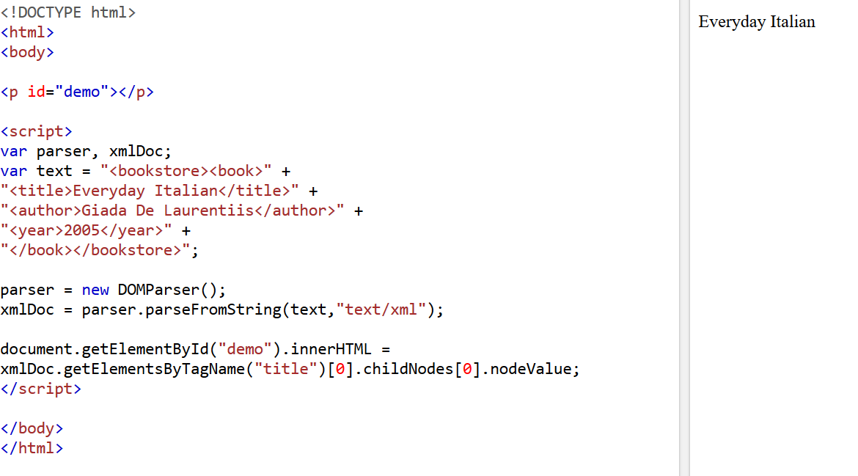
Parsing a Text String

Slide 71
SOAP
Why SOAP?
It is important for web applications to be able to communicate over the Internet.
The best way to communicate between applications is over HTTP, because HTTP is supported by all Internet browsers and servers. SOAP was created to accomplish this.
SOAP provides a way to communicate between applications running on different operating systems, with different technologies and programming languages.
SOAP Building Blocks
A SOAP message is an ordinary XML document containing the following elements:
An Envelope element that identifies the XML document as a SOAP message
A Header element that contains header information
A Body element that contains call and response information
A Fault element containing errors and status information

Slide 72
SOAP
Syntax Rules
Here are some important syntax rules:
A SOAP message MUST be encoded using XML
A SOAP message MUST use the SOAP Envelope namespace
A SOAP message must NOT contain a DTD reference
A SOAP message must NOT contain XML Processing Instructions

Slide 73
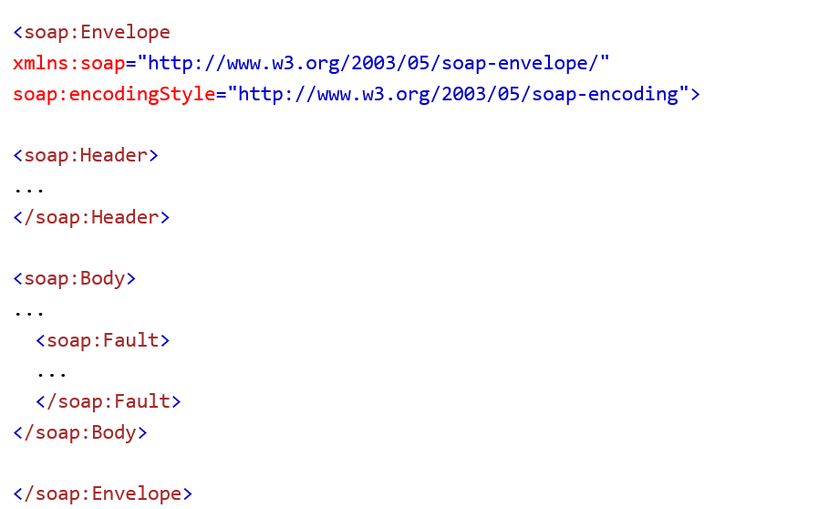
SOAP

Slide 74
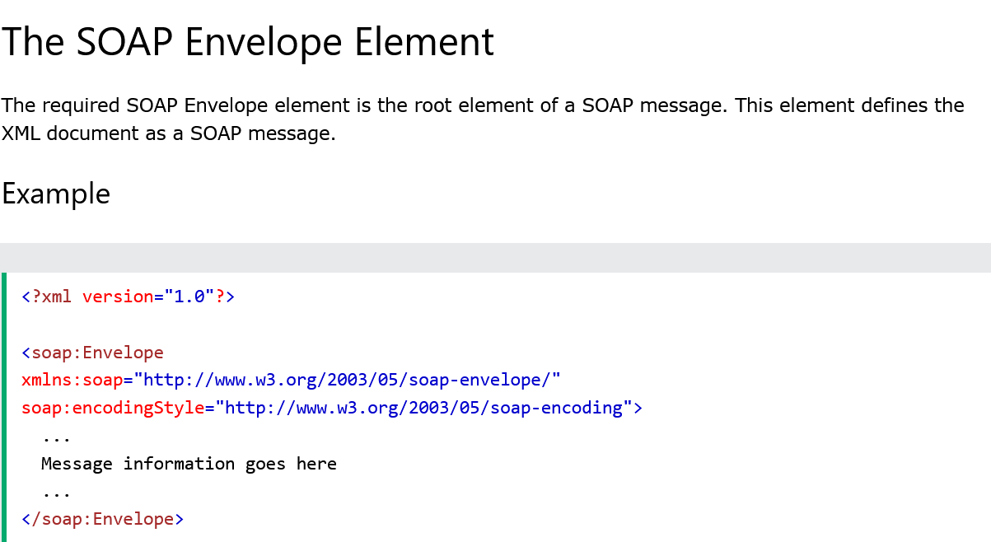
SOAP

Slide 75
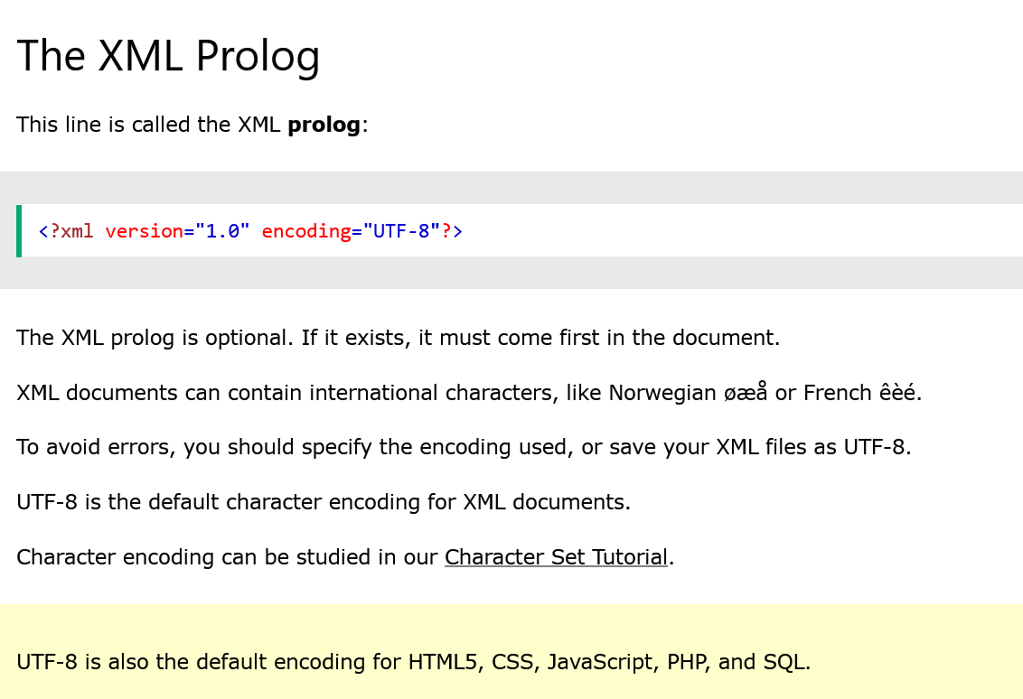
XML Prolog

